Slide 1


Ansible

Slide 2

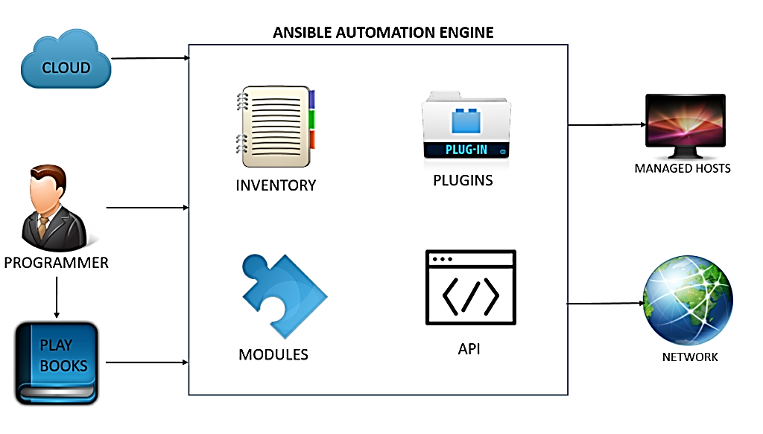

What is Ansible

Slide 3
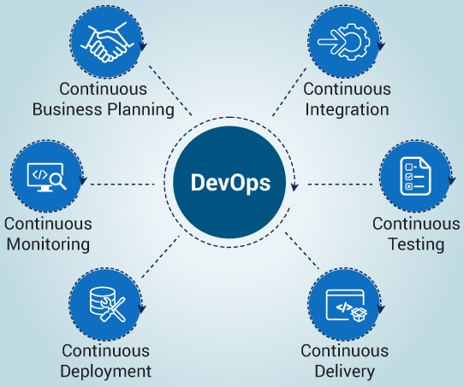
6 C’s of DevOps

Slide 4
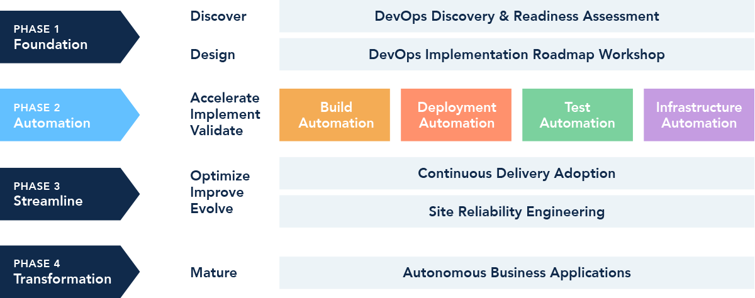
DevOps Implementation Life Cycle

Slide 5
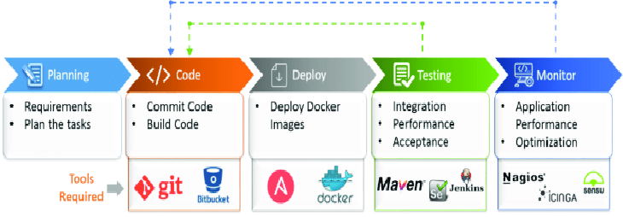
DevOps Tools for Automation

Slide 6
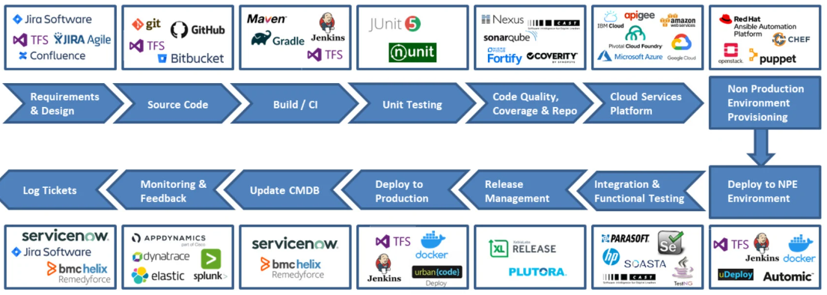
DevOps Tool Chain for Enterprise

Slide 7
What is Ansible
Ansible is an open source IT automation tool that automates provisioning, configuration management, application deployment, orchestration, and many other IT processes
Ansible is very simple to use yet powerful enough to automate complex multi-tier IT application environments.
Ansible’s uses playbooks, a small piece of YAML code, to automate almost anything related to your IT requirements.
Ansible connects to its managed servers with SSH and later pushes out small programs, known as ‘Ansible modules’ to them.

Slide 8
Why Ansible is needed
Historically, system administrators managed servers by manually installing software, changing configurations, and administering services on individual servers as per each project or process needs.
To resolve this dynamic issue many server provisioning and configuration management tools came to flourish.

Slide 9
Components of Ansible
Controller Machine is where Ansible is installed and hence is responsible for provisioning and configuration of the servers you are managing.
Inventory is the initialization file that contains information of the servers you are managing.
Module is a abstraction of a system task, like dealing with packages or creating and changing files. Ansible has a multitude of built-in modules, but you can also create custom ones.
Play is a provisioning executed by a playbook from start to finish.

Slide 10
Components of Ansible
Playbook is the entry point for Ansible provisioning, where the automation is defined through tasks using YAML format.
Role is a pre-defined way for organizing playbooks and other files in order to facilitate sharing and reusing portions of a playbook.
Task is a block that defines a single procedure to be executed, e.g. Install a package.
Facts are Global variables containing information about the system, like network interfaces or operating system.
Handlers are used to trigger service status changes, like restarting or stopping a service.

Slide 11
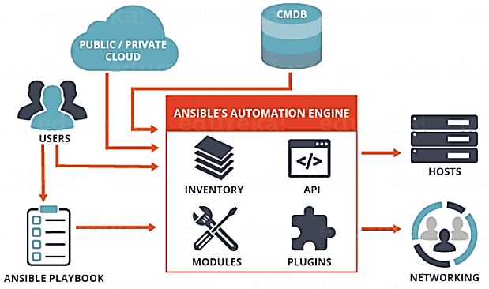
Architecture of Ansible

Slide 12
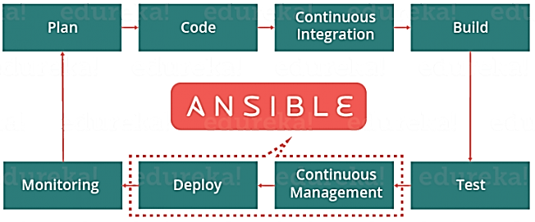

Slide 13
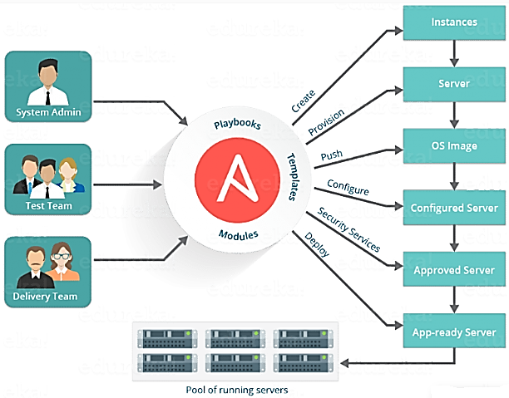

Slide 14
Advantages of Ansible
Ansible is agentless and does not install additional software on your server nodes to manage or configure them.
Ansible uses Declarative and not procedural playbooks that specify a description of the final desired state of the machine, and it takes all the essential steps to fulfill that description.
Ansible Playbooks are very easy to read or edit as they are written in simple YAML, and also easy to setup.
Ansible automates step-by-step monitoring of every task in the provisioning script, and it automatically creates color coded reports about task succeeded or failed and shows error messages if any.

Slide 15
What is IaC
IaC is infrastructure defined as, and described through code in Ansible.
IaC is the practice of configuring, provisioning and managing infrastructure through code by a written record of which services exist, where they are located, and under what environments.
IaC eases the process of continuous integration and continuous deployment techniques by reducing the elements of human error in system administration
Configuration management leverages aspects of IaC in order to achieve the full understanding of all the technology assets a company owns.

Slide 16
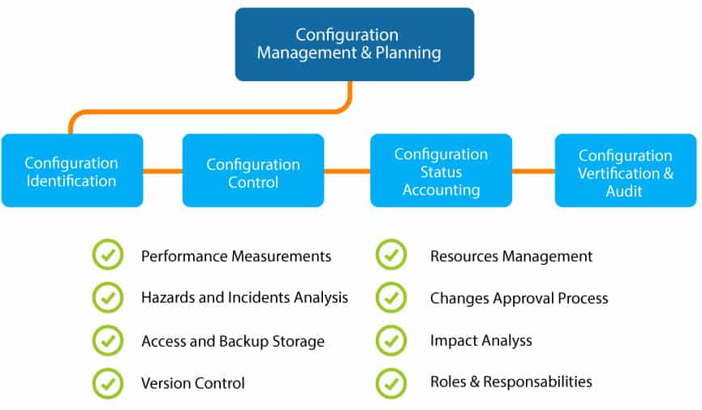
What is Configuration Management

Slide 17
What is Configuration Management
Configuration Management ensures that all software and hardware assets which a company owns are monitored and managed at all times, such that any changes to these assets are known and tracked.
Configuration Management is an always up-to-date inventory for your technology assets, a single source of truth.
Configuration management usually spans a few areas like creating “software pipelines” to build and test our software artifacts, to writing “infrastructure-as-code” to capture in code the current state of infrastructure, to store the current state of servers.
Benefits in Disaster Recovery, Uptime and Site reliability, easier scaling,

Slide 18
What are pipelines
In DevOps based SDLC, pipelines are the steps that are usually automated , taking code from commit to production.
Software Pipelines usually involve steps such as linting code, unit testing code, integration testing code, creating artifacts, etc.
Software pipeline therefore is a form of configuration management. When we build software with tools like Docker, we codify our build instructions into our Docker file. This allows us to better understand the dependencies of our artifacts.

Slide 19
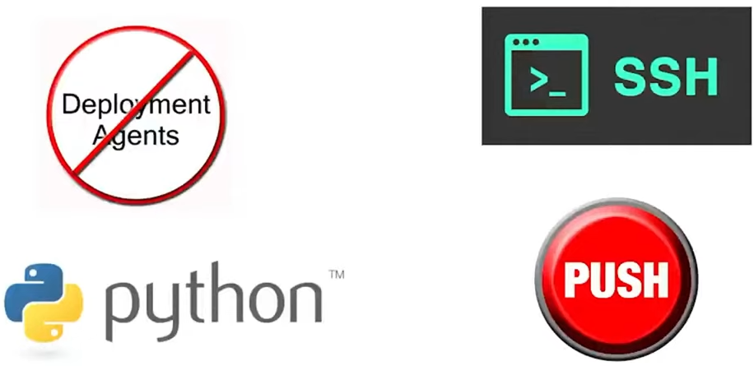
Features of Ansible

Slide 20
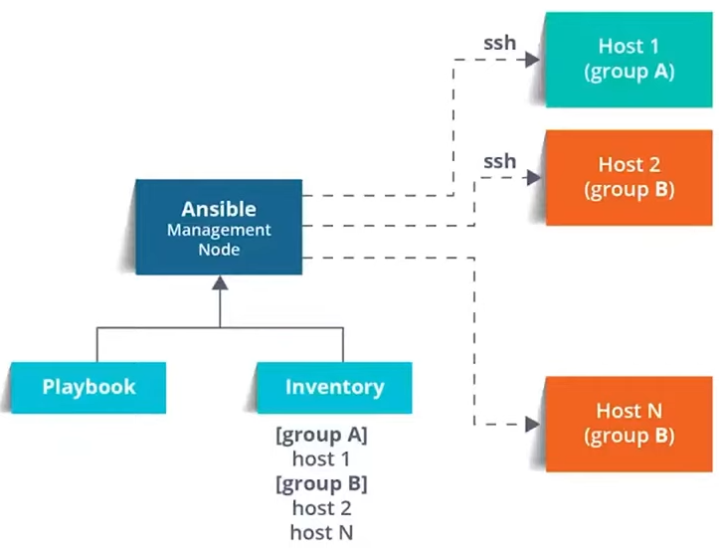
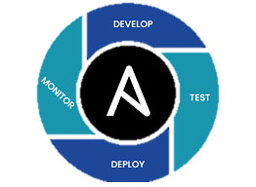
Ansible work flow

Slide 21
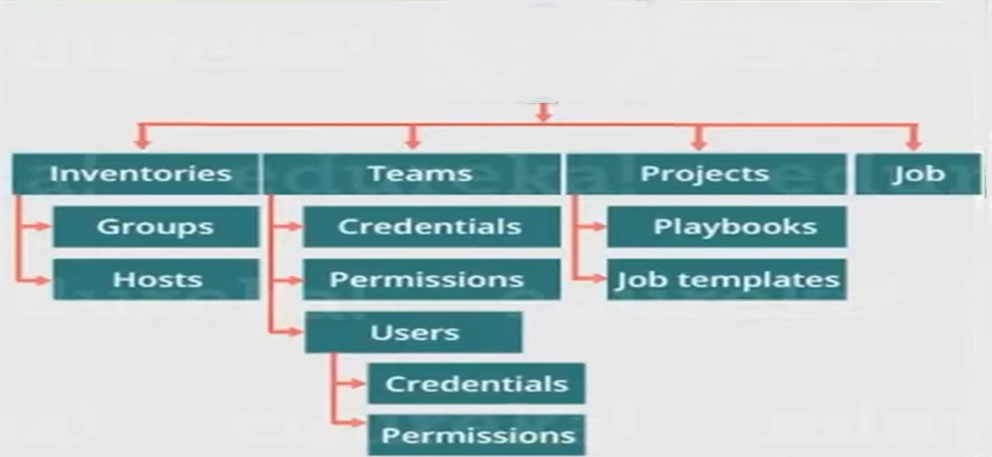
Ansible Work Flow

Slide 22
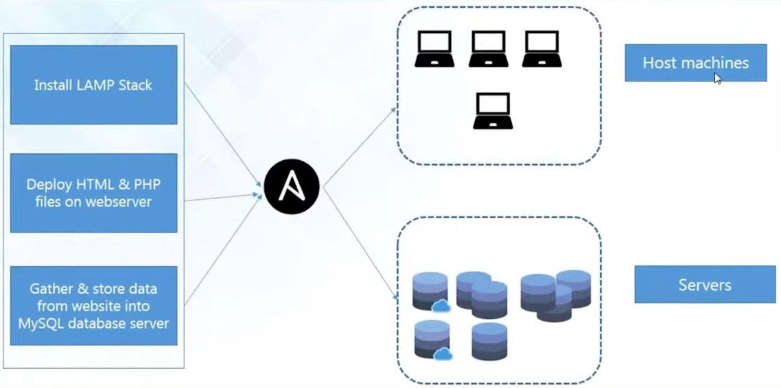
Configuring Orchestration by Ansible

Slide 23
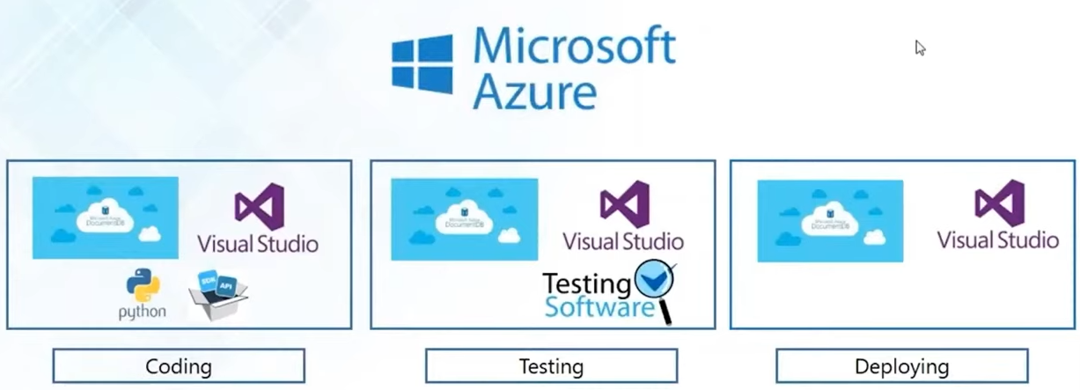
Configuring IT infrastructure provisioning by Ansible

Slide 24
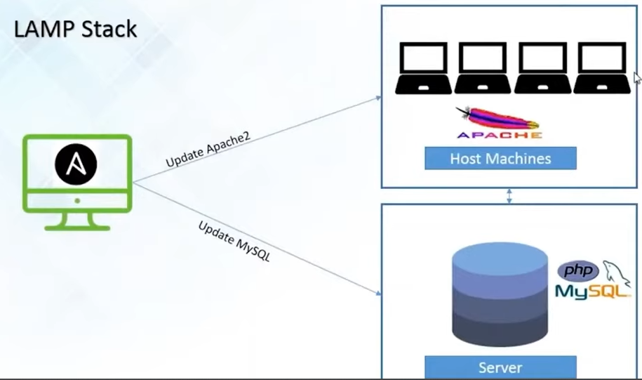
Configuration management by Ansible

Slide 25
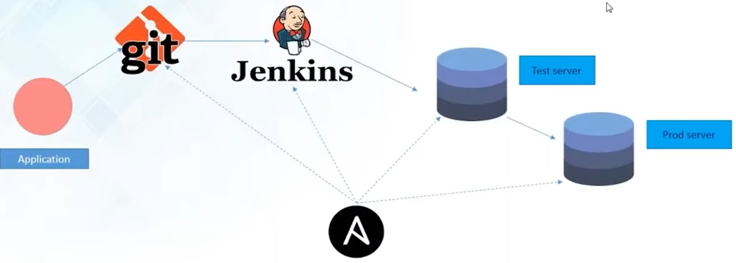
Application deployment by Ansible

Slide 26
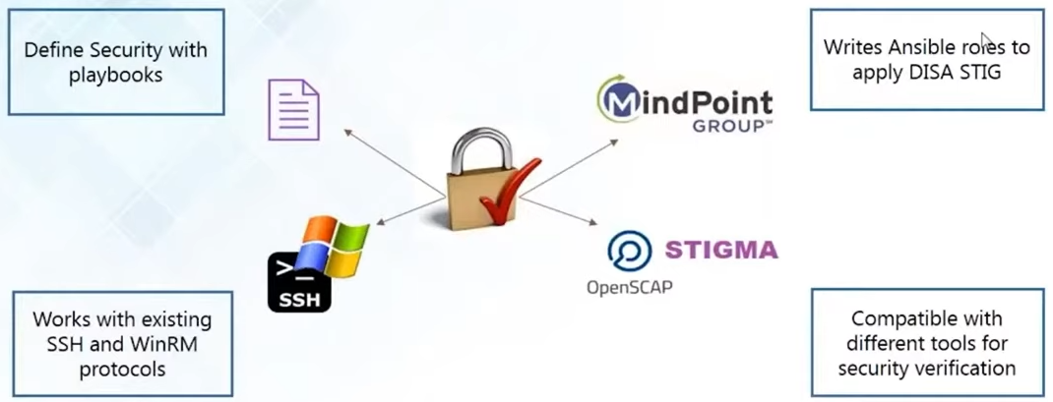
Security management by Ansible

Slide 27
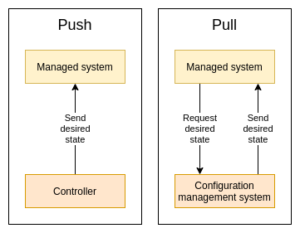
Push and Pull Configurations

Slide 28
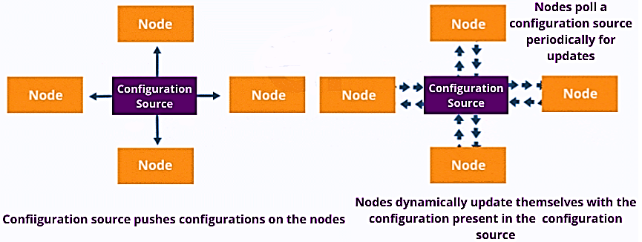
Push and Pull Configurations

Slide 29
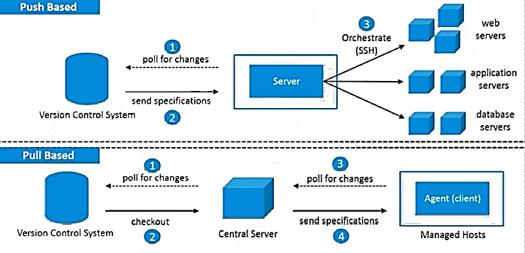
Push and Pull Configurations

Slide 30
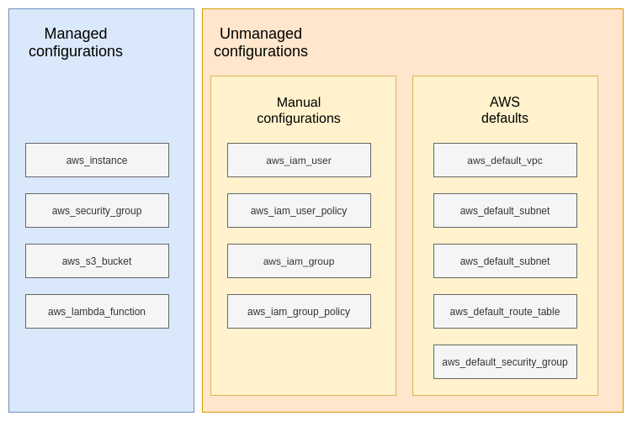
Components of a Configuration

Slide 31
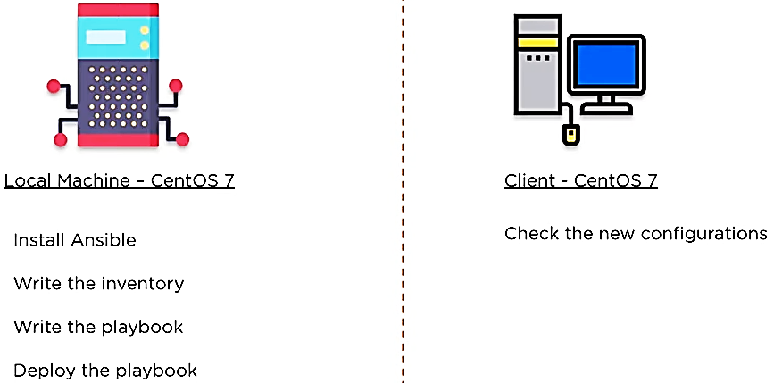
Demo environment in V Box

Slide 32
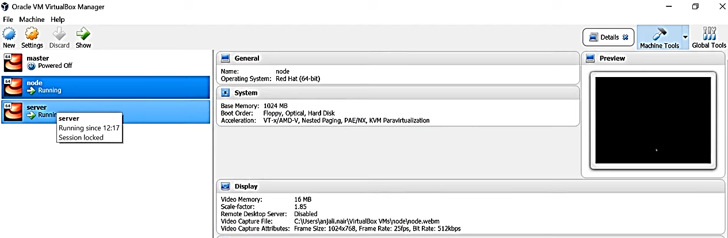
Create Master & Slave Node in Virtual Box

Slide 33
Configuring the Master Node
hostname
who
ifconfig
python3 –version
java –version
Configure the desired ip-address

Slide 34
Configuring the Slave Node
hostname
who
ifconfig
python3 –version
java –version
Configure the desired ip-address

Slide 35
Configuring the Master Node
su
vi etc/hostname
server
vi etc/hosts
192.168.100.20 localhost server
192.168.100.30 localhost slave
ping server
ping 192.168.100.20

Slide 36
Configuring the Slave Node
su
vi etc/hostname
slave
vi etc/hosts
192.168.100.20 localhost server
192.168.100.30 localhost slave
ping server
ping 192.168.100.30

Slide 37
Ansible installation on Master
Step 1: become the super su
su
Step 2: Update the System with latest packages and security patches
sudo yum -y update
Step 3: Install EPEL or Extra Packages for Enterprise Linux repository
sudo yum -y install epel-repo
Step 4: Update the repository cache by running the command.
sudo yum -y update
Step 5: Install the latest Ansible
sudo yum -y install ansible
Step 6: Check if Ansible is installed successfully by finding its version.
ansible --version

Slide 38
Create and copy SSH keys from Master to Slave
ssh-keygen
Step 1: become the super user
su
Step 2: Login to the root folder
cd /
cd root
Step 3: Create the SSH public and private keys
ssh-keygen
Step 4: check the generated directory
ls -al
Step 5: go into the ssh directory
cd .ssh

Slide 39
Create and copy SSH keys from Master to Slave
ssh-keygen
Step 6: check the SSH key pair
ls –alrt
Step 7: restart the ssh service on master and slave
systemctl restart sshd
service sshd restart
Step 8: Copy the SSH public key into the target systems (slaves).
ssh-copy-id root@192.168.100.30
Step 9: Check the connectivity
ssh root@ 192.168.100.30

Slide 40
Create and copy SSH keys from Master to Slave
Step 10: Configure the ansible hosts file
sudo vi /etc/ansible/hosts
[ansible clients]
slave ansible_host=192.168.100.30 ansible_user=root
192.168.100.30 ansible_ssh_user=root ansible_ssh_pass=admin@123
Step 11: Test the connectivity from the hosts file
ansible -m ping all

Slide 41
Ansible installation
ssh-keygen
Step 12: Check free memory on a host.
ansible -m shell -a 'free -m' host1
Step 13: Check the files in the host
ansible all -m command –a “ls”
Step 14: Setup ansible-doc
ansible-doc setup
Step 15: Check the Ansible directory
tree ansible
Step 16: Setup ansible-doc
ansible-doc setup

Slide 42
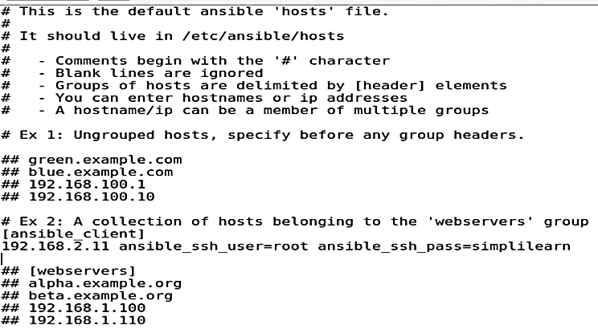
Configuring the Ansible config file

Slide 43
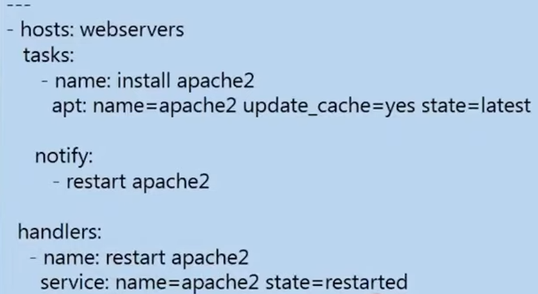
Sample play book

Slide 44
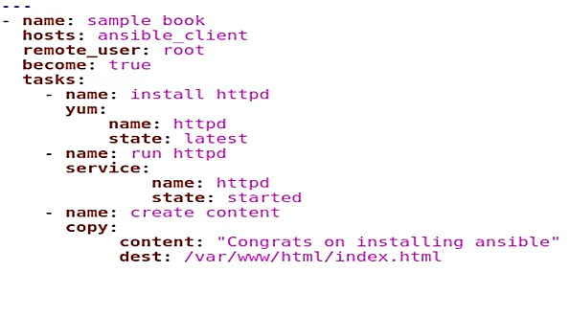
Sample.yml

Slide 45
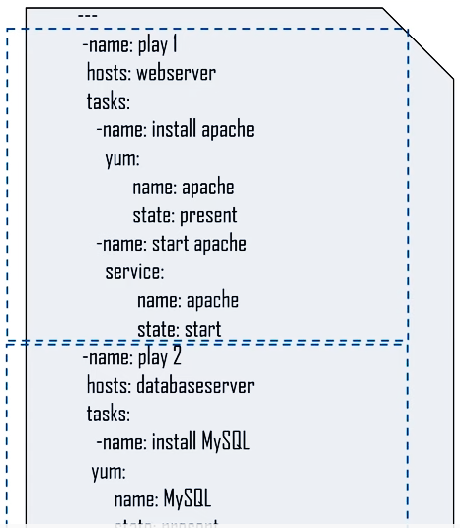

Slide 46
Sample play book
##sample playbook
---
- name: Install nginx - play book name
hosts: ansible_clients - hostname.ip or group name where this playbook will be executed
remote_user: root
become: true - escalation to super user mode to execute the tasks
tasks:
- name: Add epel-release repo
yum:
name: epel-release
state: present
- name: Install nginx
yum:
name: nginx
state: present
- name: Insert Index Page
template:
src: index.html
dest: /usr/share/nginx/html/index.html
- name: Start NGiNX
service:
name: nginx
state: started

Slide 47
Executing the playbook on the Master
Creating a playbook –
vi sample.yml
Check the playbook syntax –
ansible –playbook sample.yml –syntax –check
Execute the playbook –
ansible –playbook sample.yml
Open the browser and type localhost and search

Slide 48
Thank You
ssh-keygen

